Slide 1
Crop Analysis And Prediction
Aniket Gupta(20BCP49)
Harsh Baheti(20BCP065)
Kunal Gupta(20BCP068)

Slide 2
Abstract
As we know the fact that, India is the second largest population country in the world and majority of people in India have agriculture as their primary occupation. Farmers are growing same crops repeatedly without trying new variety of crops and they are applying fertilizers in random quantity without knowing the deficiency content. So, we have designed the system using machine learning algorithms for betterment of farmers. Our system will suggest the best suitable crop for particular land based on content and weather parameters. Our system will use Random Forest Classifier, KNN and Logistic Regression models to predict the crop. And also, the system provides information about the required content and quantity of fertilizers for cultivation. Hence by utilizing our system farmers can cultivate crops that will increase their profit margin and can avoid soil pollution.

Slide 3
Introduction
More than 60% of the land in the country is used for agriculture in order to meet the needs of 1.3 billion people. Thus adopting new agriculture technologies is very important. Initially, crop prediction and yield prediction was performed on the basis of farmers experience on a particular place. Considering all this into account machine learning helps to analyze data regarding soil conditions, including humidity, temperature, pH etc., all of which have an impact upon crop growth. Today in agriculture, this can allow crops to be grown at much higher precision, which in turn increases the effectiveness of farmers' decisions.

Slide 4
Literature Survey
A Comparative Analysis of Machine Learning Prediction Techniques for Crop Yield Prediction in India(A.P.S. Manideep, Seema Kharb):
This paper analyses a machine learning model for crop yield prediction using crop and weather data. It also compares the performance of machine learning methods like regression, decision trees, random forest and support vector machine to predict the yield of 80 crops in India using historical data. Among the mentioned ML methods the decision tree regressor turned out to be a good regressor but a weak learner and is more prone to overfitting, linear regression is a simple algorithm but can not work well on complex data while random forest regressor performed well on both training and testing datasets because of it's non-linear and ensemble nature. Hence the paper concluded that for the crop prediction dataset used, random forest classifier turned out to give one of the best accuracy among all others.

Slide 5
Related Work
Crop Prediction System using ML proposed by Pavan Patil, Virendra Panpatil and Shrikant Kokate is a efficient crop recommendation system that focused on rainfall and weather reports to classify the appropriate crop. This model was evaluated using KNN, Naive Bayes and Decision Tree Classifier and Naive Bayes turned out to give better accuracy among the three.
Machine learning approaches for crop recommendation and rainfall prediction proposed by Ashwini Kumar, Mahendra N. and Dhanush Vishwakarma described different ML approaches like SVM, KNN and Logistic Regression to predict rainfall and crop yield. They used temperature, humidity, pH and rainfall as features for prediction and concluded that KNN have the highest efficiency for crop prediction.
Prediction of Crop fertilizer consumption by Krutika Hampannavar and Vijay Bhajantri used SVM to predict crop fertilizers comsumption. They focused on features like Nitrogen, Potassium and other soil nutrients for prediction.

Slide 6
Dataset Description
The model utilizes agricultural dataset that includes soil and environmental factors.
The dataset consists of 2200 instances, 7 feature attributes and a target class.
The target class is a multiclass with 22 different classes.
The dataset is balanced with 100 instances per class.
This dataset will be used in the supervised learning model.
The different class of the dataset are {rice : 20}, {maize : 11}, {chickpea(chana) : 3}, {kidneybeans(rajma) : 9}, {pigeonpeas(tur dal) : 18}, {mothbeans : 13}, {mungbeans : 14}, {blackgram(Urad dal) : 2}, {lentil(masoor dal) : 10}, {pomegranate : 19}, {banana : 1}, {mango : 12}, {grapes : 7}, {watermelon : 21}, {muskmelon : 15}, {apple : 0}, {orange : 15}, {papaya : 17}, {coconut : 4}, {cotton : 6}, {jute : 8}, {coffee : 5}.

Slide 7
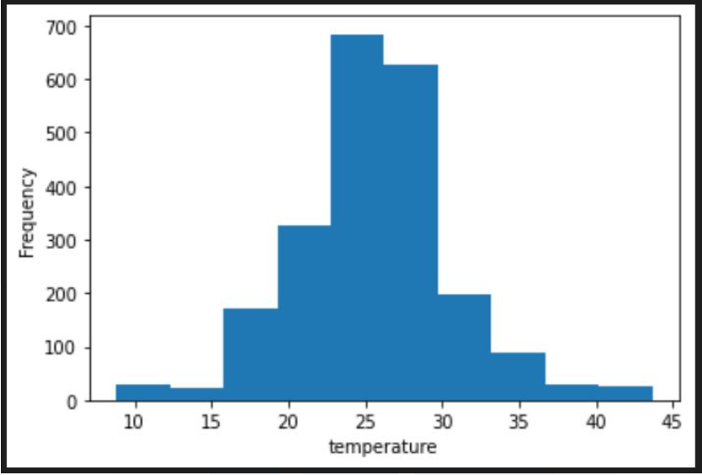
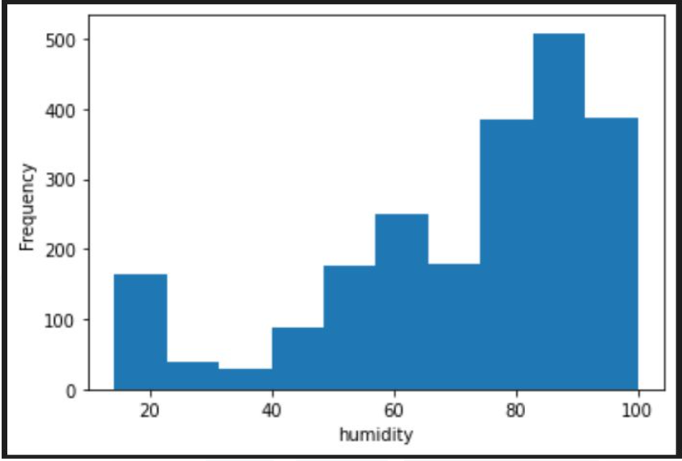
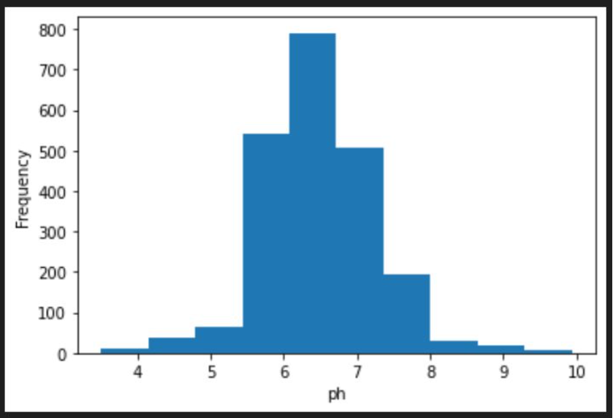
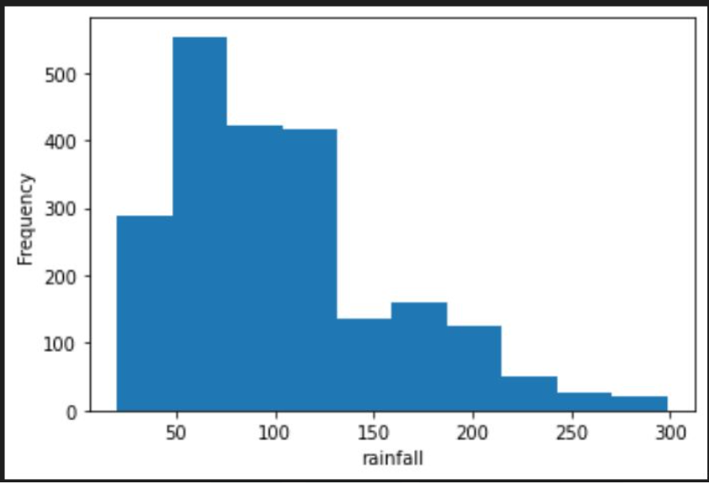
Dataset Description
Proposed model predict crop based on temperature(float datatype), humidity(float datatype), pH(float datatype), rainfall(float datatype), nitrogen(integer datatype), phosphorus(integer datatype), potassium(integer datatype).
This also gives an idea about the proper amount of fertilizers to use for the cultivation.

Slide 8
Proposed Work
The proposed model is a multiclass classification model i.e. a supervised learning model.
Dataset is collected from kaggle.com.
DATA CLEANING : Data should be cleaned and erroneous, duplicate and correlated data will be taken care of.
DATA PREPROCESSING : Label encoding will be done before training the data.
MODEL TRAINING : Model will be splitted into training and testing dataset and will be evaluated using Random Forest Classifier, Logistic Regression and KNN.
MODEL TESTING : Testing the model on the basis of testing dataset.

Slide 9
Conclusion
Presently our farmers are not effectively using technology and analysis, so there may be a chance of wrong selection of crop for cultivation that will reduce their income. To reduce those type of loses we have developed this model which will predict the best suitable crop for particular land and will also provide information about required nutrients to add up for better cultivation. This way ML will help in the growth of agricultural sector.

